Slide 1

PROJECT TITLE Driver Slumped driving Identification System Date: 01/05/2023
Major Project (ICI651)
Degree : BCA(CTIS)I-NURTURE
Project Guide:
MR. VIJAY PRAKASH
ABHAY SAXENA (TCA2056003)
AVIRAL YADAV(TCA2056006)
BOBY SHARMA(TCA2056007)
VIKESH KUMAR(TCA2056026)
FACULTY OF ENGINEERING & COMPUTING SCIENCES
TEERTHANKER MAHAVEER UNIVERSITY, MORADABAD

Slide 2

Team Details
Student Name | Role
ABHAY SAXENA , VIKESH KUMAR | Researcher,Developer,coder
BOBY SHARMA , AVIRAL YADAV | CO-member, Tester
Guidelines: Mention Team Names & their role in project
2
T011A/ Template Version 5.0

Slide 3
PROJECT Brief
The aim of this project is to develop a prototype drowsiness detection system. The focus will be placed on designing a system that will accurately monitor the open or closed state of the driver’s eyes in real-time. By monitoring the eyes, it is believed that the symptoms of driver fatigue can be detected early enough to avoid a car accident. Detection of fatigue involves the observation of eye movements and blink patterns in a sequence of images of a face. Initially, we decided to go about detecting eye blink patterns using Matlab. However Matlab had some serious limitations. The processing capacities required by Matlab were very high. Also there were some problems with speed in real time processing. Matlab was capable of processing only 4-5 frames per second. On a system with a low RAM this was even lower. As we all know an eye blink is a matter of milliseconds. Also a drivers head movements can be pretty fast. Though the Matlab program designed by us detected an eye blink, the performance was found severely wanting. This is where OpenCV came in. OpenCV is an open source computer vision library. It is designed for computational efficiency and with a strong focus on real time applications. It helps to build sophisticated vision applications quickly and easily. OpenCV satisfied the low processing power and high speed requirements of our application.
3
T011A/ Template Version 5.0

Slide 4
Methodologies/Technologies/Tools to used
used
Software Platform
Visual Code
Keras
Python Idle 3.10
Command Prompt
Hardware Platform
i5-11 Gen
8GB RAM
512 SSD
4
T011A/ Template Version 5.0

Slide 5
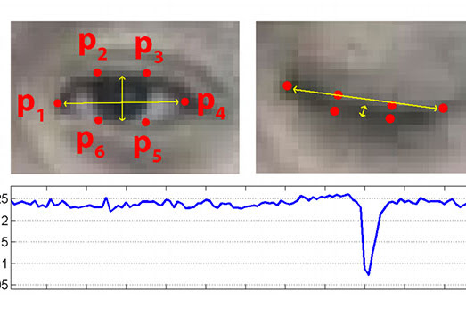
Methodologies

Slide 6

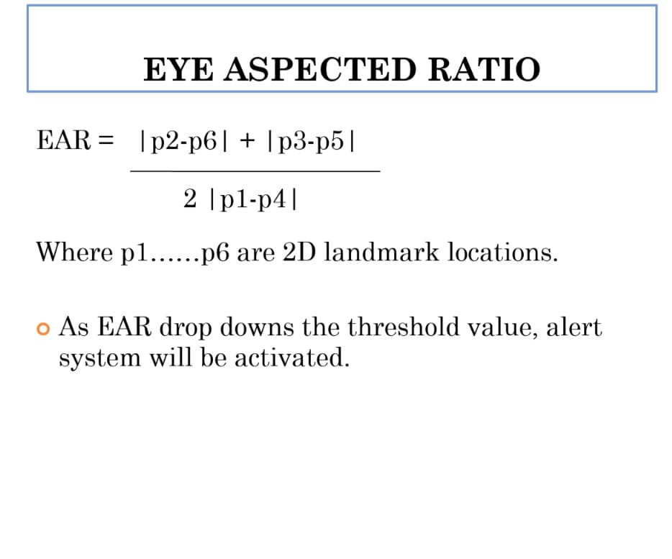

Slide 7
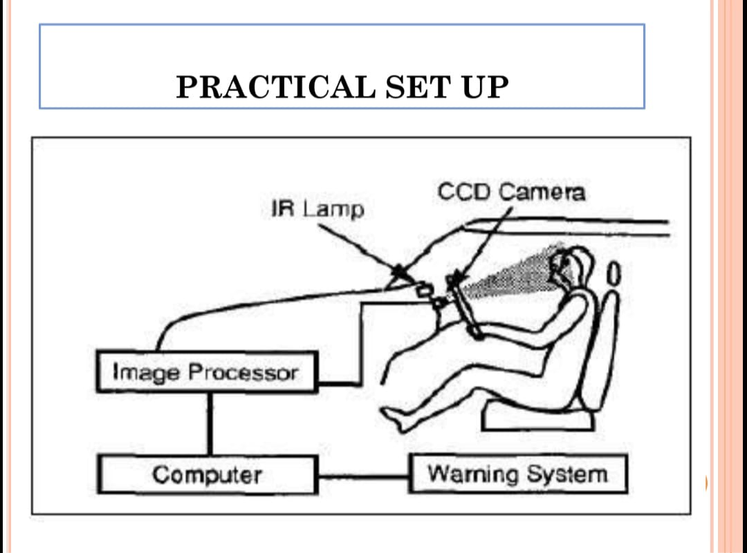

Slide 8
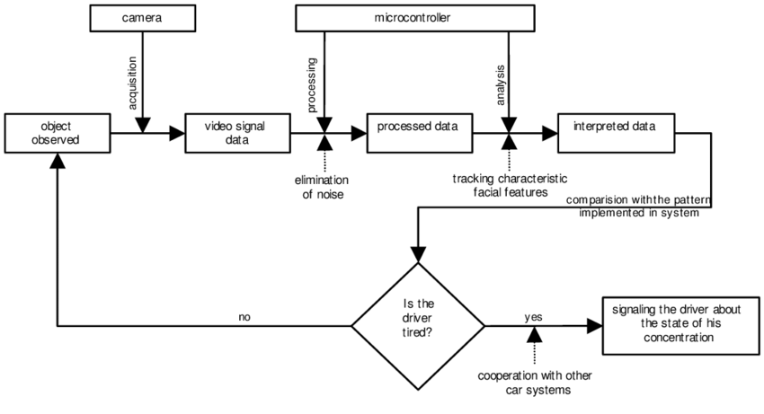
Context Diagram
8
T011A/ Template Version 5.0

Slide 9
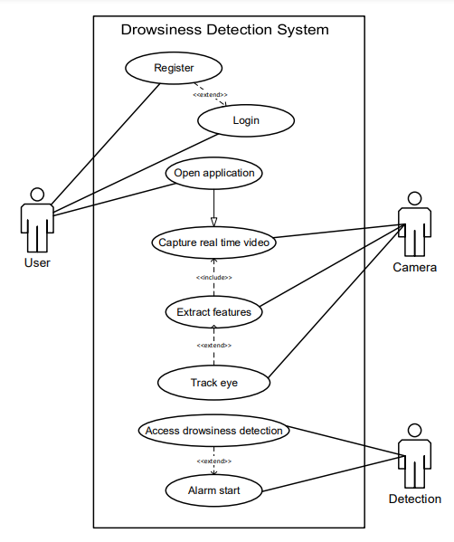
Data flow Diagram
9
T011A/ Template Version 5.0

Slide 10
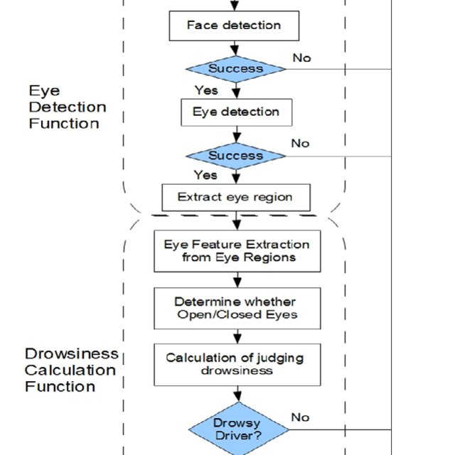
Flow chart
10
T011A/ Template Version 5.0

Slide 11
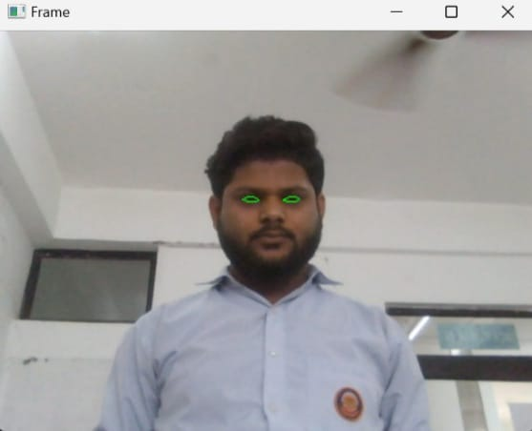
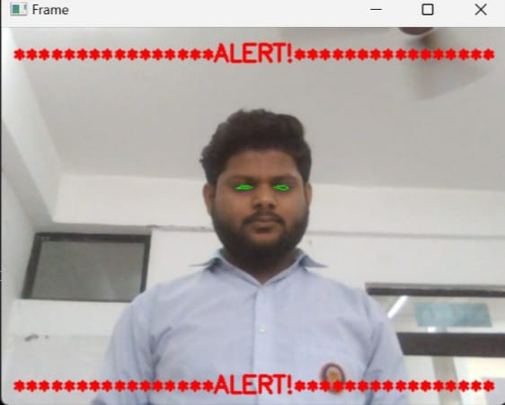
Experiment result(sample 1)
11
T011A/ Template Version 5.0

Slide 12
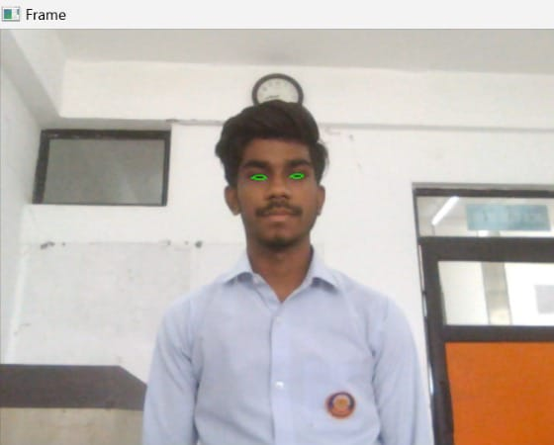
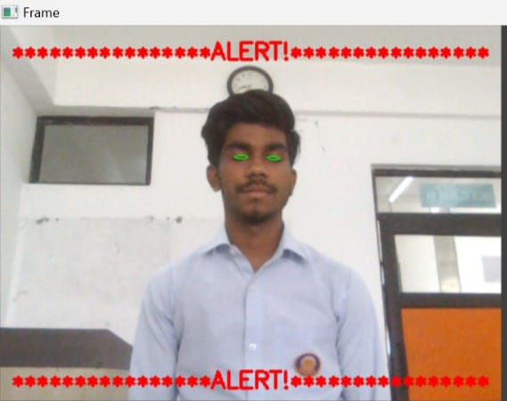
Sample 2
12
T011A/ Template Version 5.0

Slide 13
Advantages of project
The detected abnormal behavior is corrected through alarms in real time.
Component establishes interface with other drivers very easily. Life of the driver can be saved by alerting him using the alarm system.
Speed of the vehicle can be controlled.
Traffic management can be maintained by reducing accidents.
Practically applicable.
Use to prevent for ancident
Safe the driver and decrease acident.
13
T011A/ Template Version 5.0

Slide 14
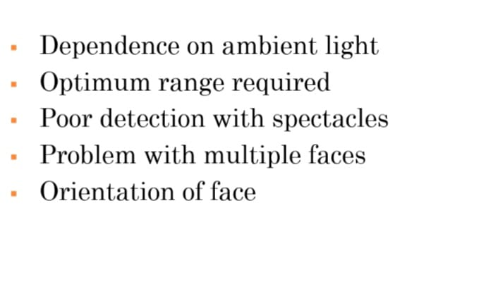
LIMITATIONS
14
T011A/ Template Version 5.0

Slide 15
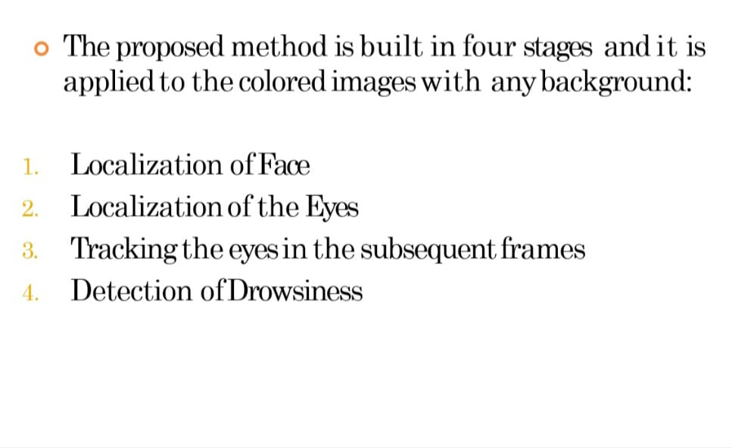
\
TECHNIQUES FOR DETECTING
DROSINESS STATE
Guidelines: Mention advantage from this project, the audience/ users who will get benefitted
15
T011A/ Template Version 5.0

Slide 16
REFRENCES
[1] “Development of drowsiness detection system” VehicleResearch Laboratory, Nissan Center NISSAN MOTOR Co., Ltd. Hiroshi Ueno Masayuki Kaneda Masataka Tsukino [2] “Face and eye tracking algorithm based on digital image processing “Department of Electrical Engineering, Universidad de Chile AV. Tupper 2007. Claudio A. Perez, Alvaro Palma, Carlos A. Holzmann and Christian Pera [3] “Active Accident Avoidance Case Study: Integrating Drowsiness Monitoring System with Lateral Control and Speed Regulation in Passenger Vehicles” Proceedings of the 2008 IEEE International Conference on Vehicular Electronics and Safety Columbus, OH, USA. September 22- 24, 2008. Pınar Boyra, John L. Hansen
16
T011A/ Template Version 5.0

Slide 17
THANKS

